Slide 1
Game Tools Dev
Carl Jones 2023

Slide 2
Confirm last weeks code is working
Call you NavSet draw method in LevelEditor.cpp
In the render loop directly under:
drawModelHierarchy(&GUI.scene.rootModel, &I, &viewProjectionMatrix);
Add:
GUI.scene.navSet.draw(viewProjectionMatrix);
Now run the code and you should be able to add a NavPoint by selecting “Add Node” from the menu.
You should see a node added in the middle of the scene.
You should be able to select a node by clicking on it. You should be able to move the node by clicking on it.
Note: Make sure you are in the plan view, and you might need to press “m” to toggle between “move Camera mode ” and “move Model Mode”.

Slide 3
Where to start
Review the notes on XML file reading and writing from earlier in the module.
I recommend you first try to save NavPoints to a standalone XML file as opposed to embedding the NavPoints in the main scene XML file.
It will be easier for debugging both saving and loading.
Once you can load and save a NavPoint file it is relatively easy to call loadNavPoints and saveNavPoints functions while reading or writing the Level01.xml.

Slide 4
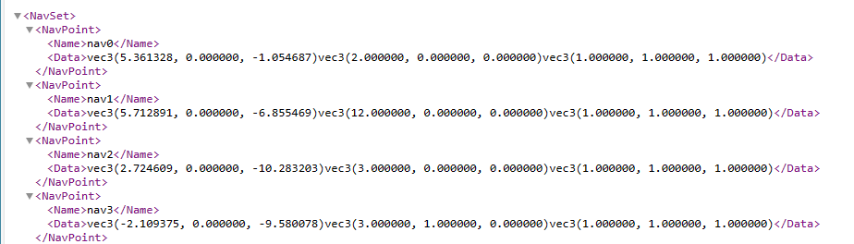
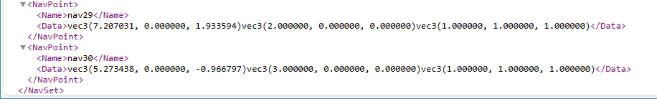
NavSet01.xml
The NavSet01 xml file should look something like the following:
Ending:

Slide 5
Things to consider
Review the Model class
It contains methods for writing the model properties to the Level01.xml file:
std::string toXML()
The NavPoint class will need a similar function to save its properties to NavSet01.xml
The model class also contains the methods to help with loading properties from an XML file
glm::vec3 vecFromStr(string& str)
Takes text data read from the xml file and and extracts one GLM vec3 from the data each time it is called.
void setData(string& data)
Takes the block of data read from an xml file and calls vecFromStr 3 times to load the 3 vectors for a model.
These methods can be added to the NavPoint class.

Slide 6
Adding load and save NavPoints menu items
In void GUIMgr::drawMenu()
Add a menu item:
if (ImGui::MenuItem(“Save Nodes", "Ctrl+?"))
scene.saveNavPoints();
And another menu item:
if (ImGui::MenuItem(“Load Nodes", "Ctrl+?"))
scene.loadNavPoints();

Slide 7
Saving a NavSet could be a method of the Scene class
void Scene::saveNavSet() Pseudocode:
Open an XML file: "..\\..\\Resources\\Levels\\NavSet01.xml" for writing
if opened correctly
{
write the "<NavSet>“ start tag
for each navPoint
{
write the "<NavPoint>“start tag
Call the navPoint[].toXML() method to write its data
write the "</NavPoint>" end tag
}
write the "</NavSet>" end tag
Close the xml file
}
else
handle error

Slide 8
Loading a NavSet could also be a method of Scene
void Scene::loadNavSet() Pseudocode:
Empty NavPoint vector
Set CurrentNavPoint to 255
Set selected_navPoint to nullptr;
Open an XML file: "..\\..\\Resources\\Levels\\NavSet01.xml" for reading
if opened correctly
{
read the navSetElement (root element of the document)
read the first navPointElement(first child element with "NavPoint tag)
While navPointElement
{
read the navPointElement "Name"
read the navPointElement “Data"
create a new NavPoint and add it to the navSet.navPoints vector (pass the data to the NavPoint constructor)
Set the new NavPoint.ID to CurrentNavPoint
Decrement CurrentNavPoint
Get the next sibling element with "NavPoint" tag
}
Close the xml file
}
else
handle error

Slide 9
To Do…
Write NavPoints to an XML file
Read NavPoints from an XML file
Save Navpoints with the Scene
Load NavPoints with the Scene

Slide 10
Possible Enhancements
Custom Shaders to draw NavPoints
Use inheritance to simplify the code

Slide 11
Next Week…
Assignment:
Draw navPoints to the object tree
Back to the module:
Drawing and managing multiple viewports in a GUI

